Slide 1
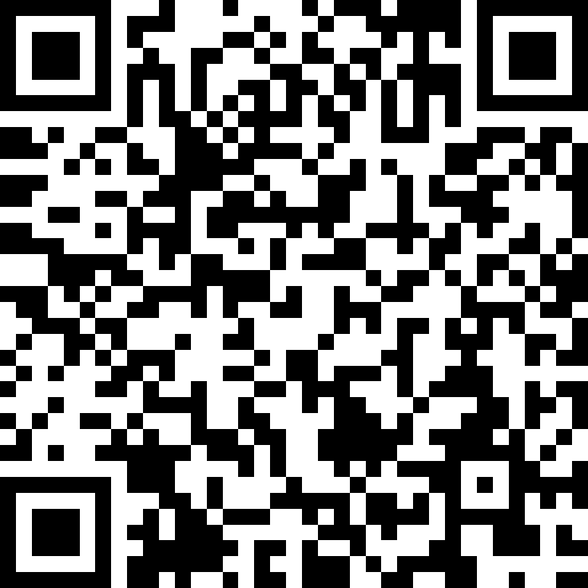
ACCESSIBILITY INCLUDES COMMUNICATION
Communication Access is about what you can do to communicate effectively with me when I use your business or service.
We want to be able to:
Understand what you are saying.
Have you understand our messages.
Use the communication methods that work best for
us.
Access the supports we need to communicate with
you and your staff, at meetings, public forums and
over the telephone.
Read and understand your written information.
Sign your documents and complete your forms.
@ISAAC International
NAACA is grateful to CDAC for the use of the Communication Access Symbol and information used for the creation of this brochure.

Slide 2
THINGS YOU CAN DO
Everyone is different and has different accessibility needs. Here are some simple communication tips to get you started.
Don´t be afraid, talk directly to us, not just to the person with us.
Please do not underestimate our abilities.
Speak in a normal tone and volume.
Assume we understand, unless we tell you otherwise.
Ask what you can do when communicating with us.
If you are not sure how we communicate “Yes” and “No”, please ask us to show you.
Watch and listen. We may use our speech, body language, a communication board, device, or human assistance.
Be patient. It takes us longer to communicate. We may need extra time at an appointment.
Tell us if you don’t understand. We may want to repeat or change our message. Sometimes it helps to move to a quiet place so that you can focus on what we are communicating.
If we seem to have difficulty understanding what you are saying, try using everyday language, speaking clearly, or showing us what you are talking about.
Please ask us if we have trained communication assistants to support our participation in a meeting or when using your services.
Ask if we need assistance to read your materials, complete forms, take notes, or sign any documents.
SPACE TO SHARE PHOTO
Millions of people in the world have speech and language disabilities that make communication difficult. We may be children, or adults and may have a variety of diagnoses like Cerebral Palsy, Autism Spectrum Disorder, Cognitive Disability, Traumatic Brain Injury, Aphasia, Amyotrophic Lateral Sclerosis, Parkinson’s Disease, Multiple Sclerosis, Down Syndrome, or other conditions.
We communicate in different ways:
Some of us have speech that may be difficult for you to understand.
Some of us communicate using communication boards, devices or human assistance.
Some of us may also have difficulty understanding what you are saying.
We will be able to use your services if you learn how to communicate with us.
Remember that attitude and knowledge makes the difference.

